Slide 1
Create your account
Welcome to
Username
Enter a username
Locale
Email
Enter your email address
Built for citizens, by citizens.
Password
Enter a password
Confirm your password
✓
By signing up, you agree to the terms & conditions
Sign Up
Sign In
Aaron W.
Albert M.

Slide 2









Inspiration for the login screen
Input verification
Welcome text
Sign up and sign in buttons
Names of creators

Slide 3
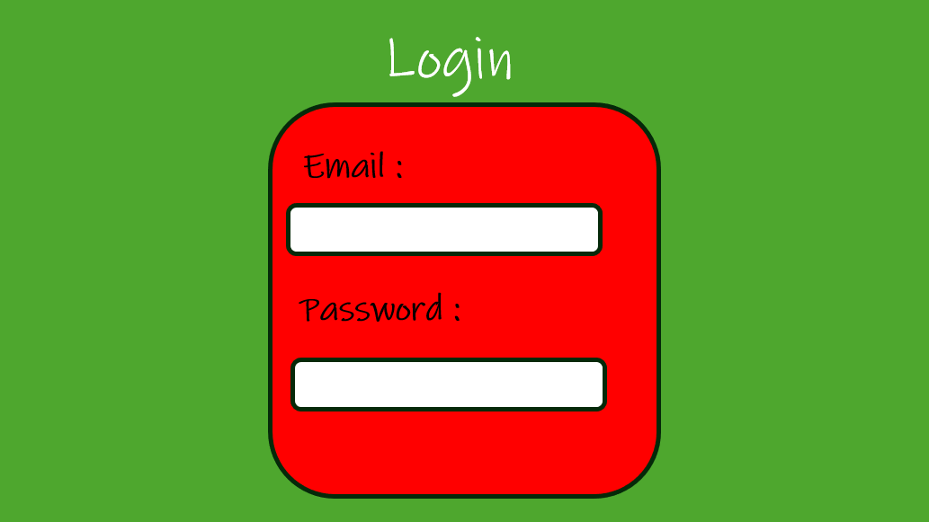


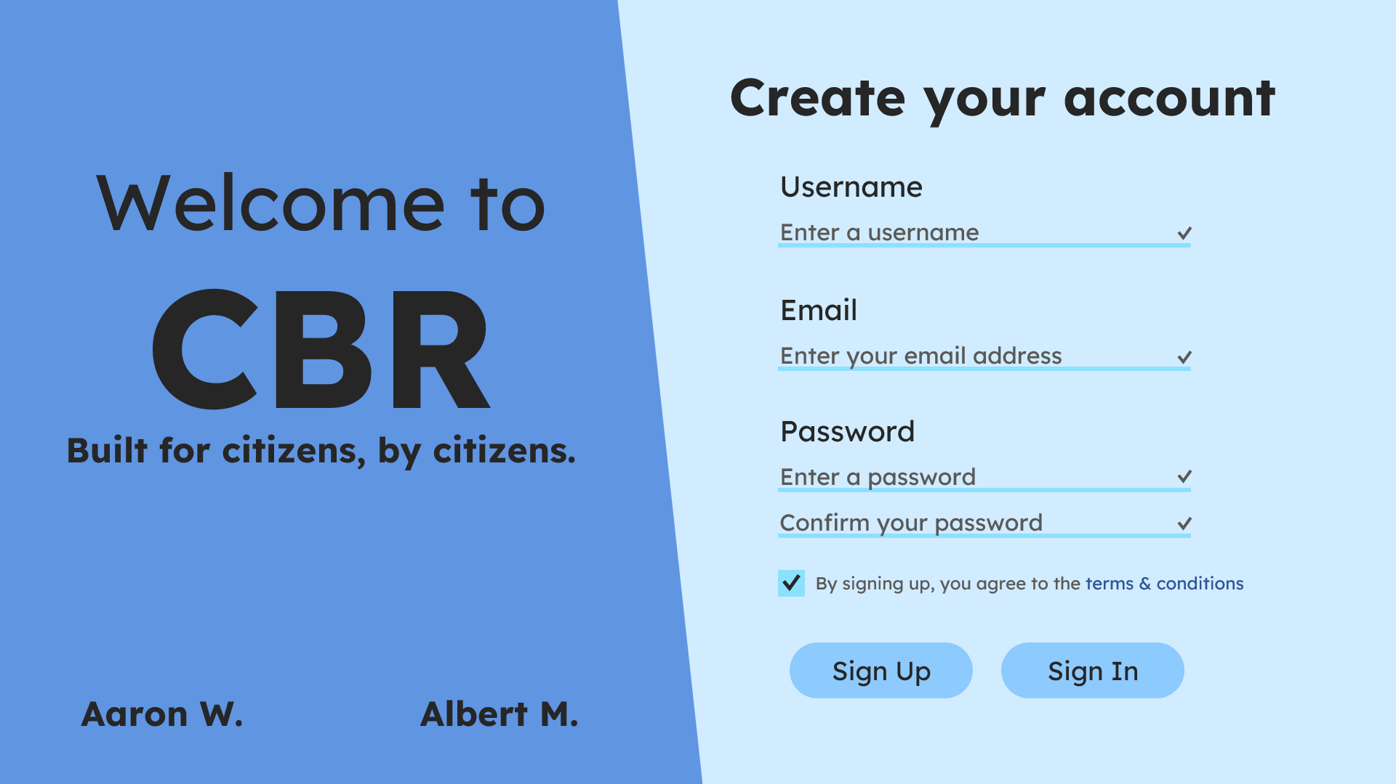
Design Evolution
Random design
First draft
Second draft
Most recent revision

Slide 4

Locale
Log in
Sign up
Built for citizens,
by citizens.
A free-forever platform to give your neighbors a heads-up when they need one most.
Enter your email address
Get started

Slide 5
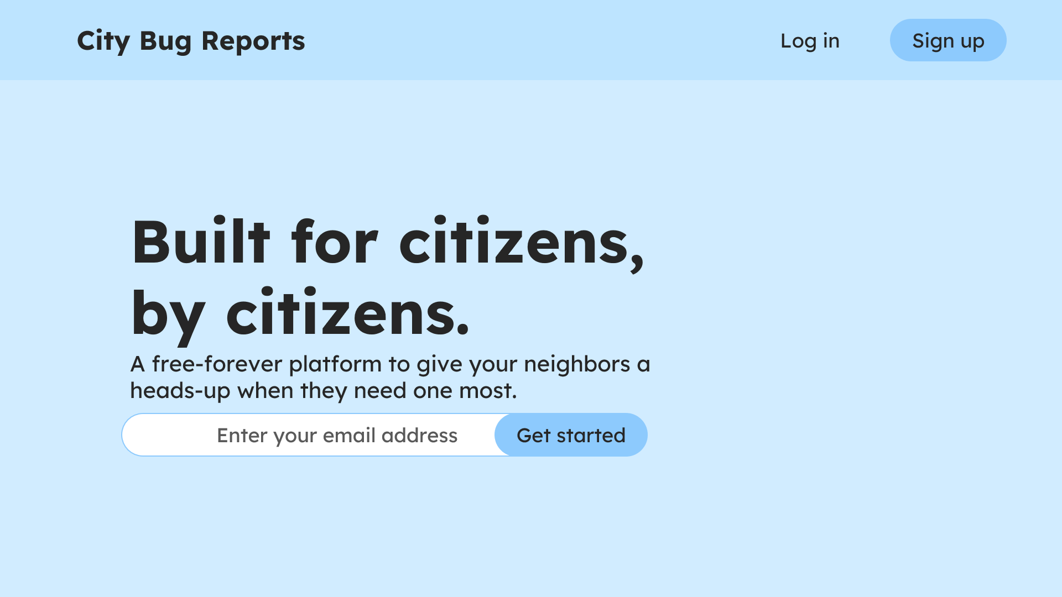
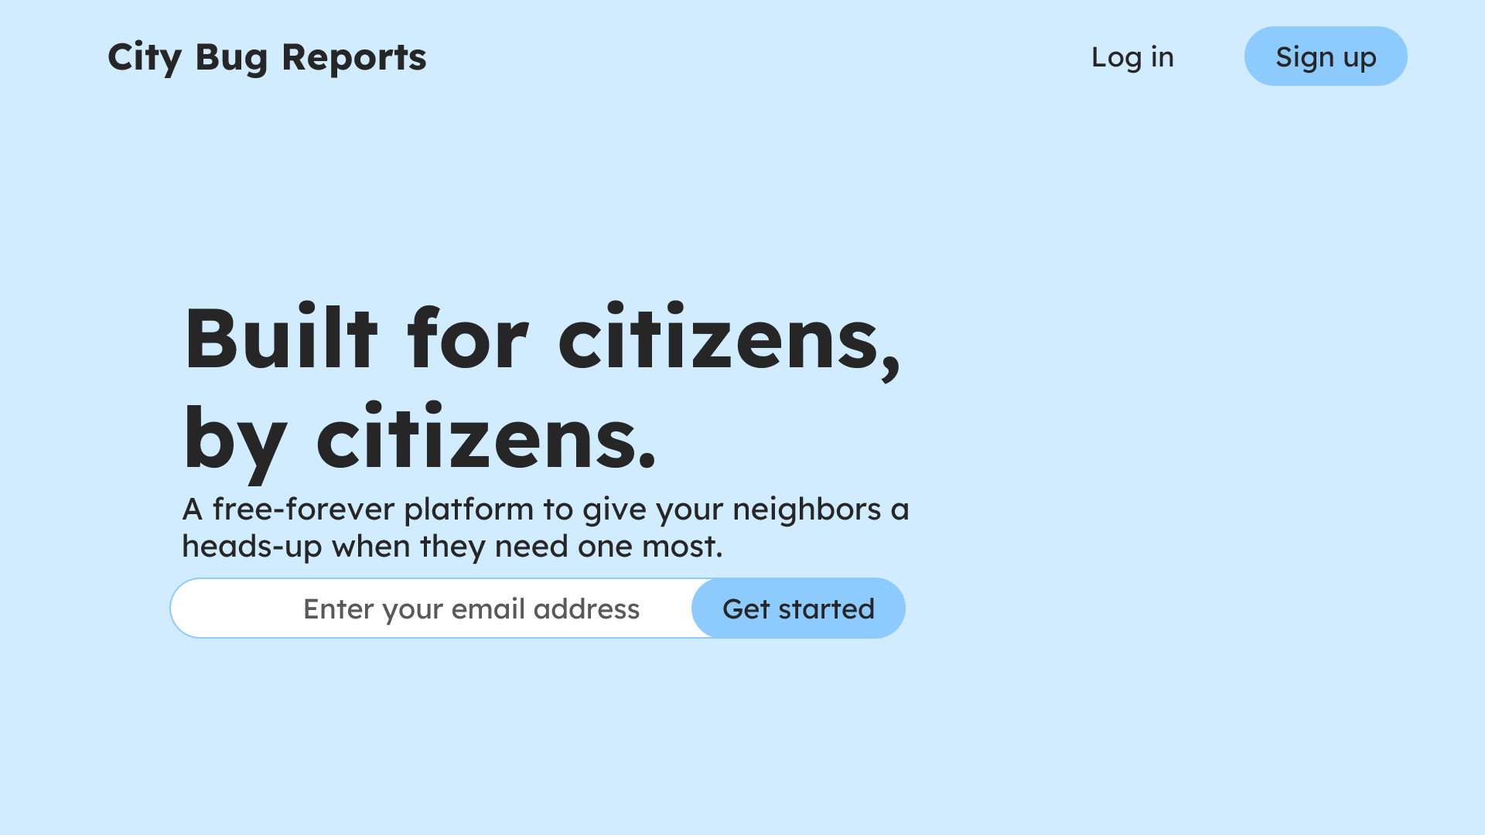

Design Evolution
First Draft
Second draft
Second draft
Most recent revision

Slide 6





Markers
Current Position
Current Issue
Medium Risk Issue
Low Risk Issue
High Risk Issue

Slide 7
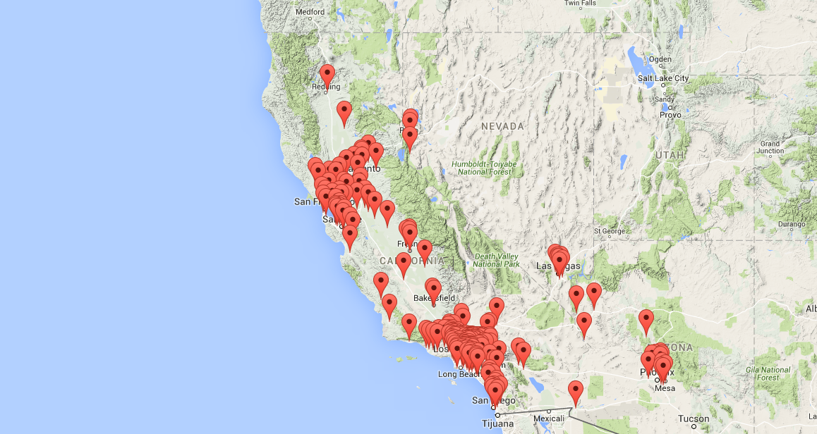
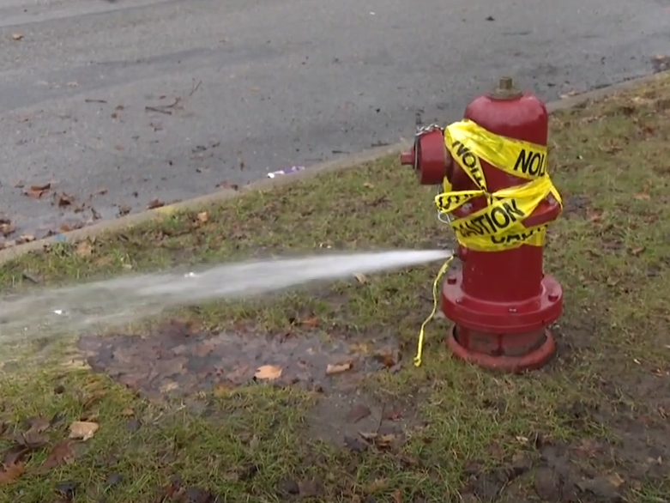

Locale
Dashboard
Broken Fire Hydrant
1234 West 27th Avenue
Status: Active
Watch out for: water, flooding
Risk

Slide 8
Locale
Dashboard
Report an issue
What should we watch out for?
describe the issue in a few words
How would you rate this issue?
Upload an image:
Upload

Slide 9
Locale
Moderator dashboard
Latest Issues
Broken firehose
49 Knight Street
….read more
Pothole
49 Knight Street
….read more

Slide 10
Locale

